Slide 1
Customer Retention Project

Slide 2
Problem Statement
To predict factors that are responsible for customer retention in online shopping websites.
The data for this project was collected from the Indian online shoppers.

Slide 3
Background
Based on previous study it has been observed that the five major factors that contributed to the success of an e-commerce store have been: service quality, system quality, information quality, trust and net benefit.
The combination of both utilitarian value and hedonistic values are needed to affect the repeat purchase intention (loyalty) positively.

Slide 4
EDA Procedure
First step is to get insight of the dataset by determining the shape of data and finding the data type.
Next we perform null value analysis to detect void in the cell and if found it is replaced with mean (for non-categorical features ) and mode (for categorical features).
Since the entire dataset is of categorical type, we avoid skew, outlier or any other statistical analysis.
Using visualization techniques we perform univariate, bivariate analysis. Some of the examples are –

Slide 5
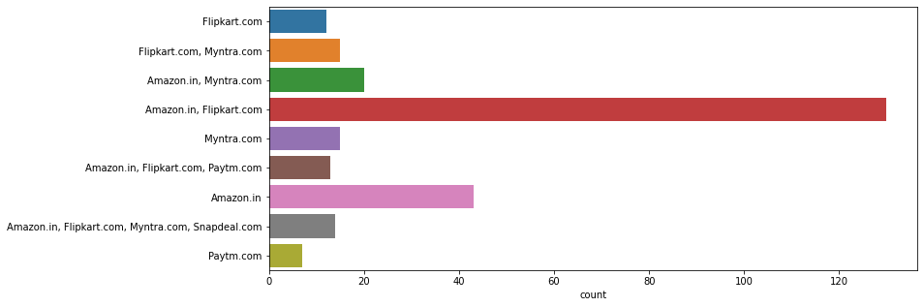
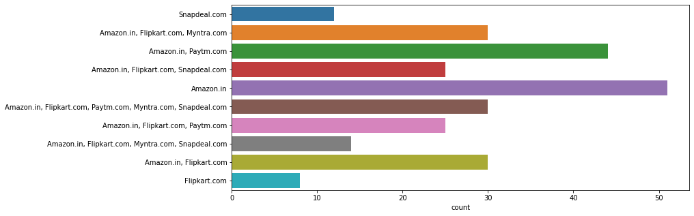
, Univariate analysis (Sample obtained from python notebook)
Wide variety of product offers
Loading speed of the website

Slide 6
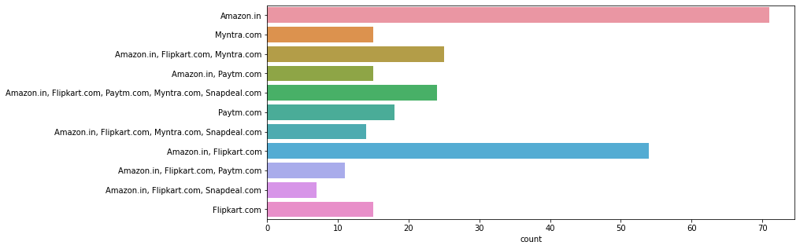
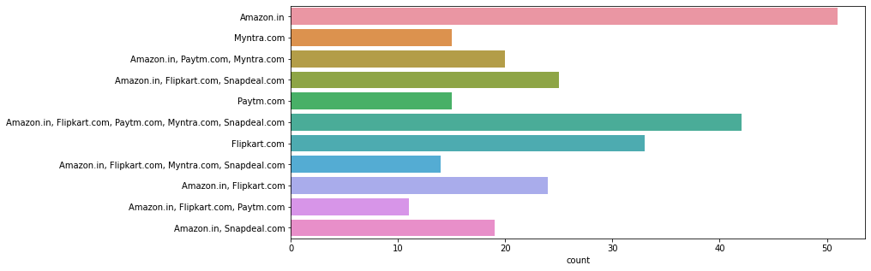
Customer Information privacy protection
Customer financial information protection

Slide 7
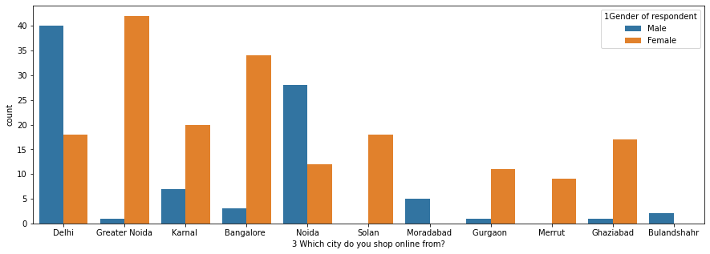
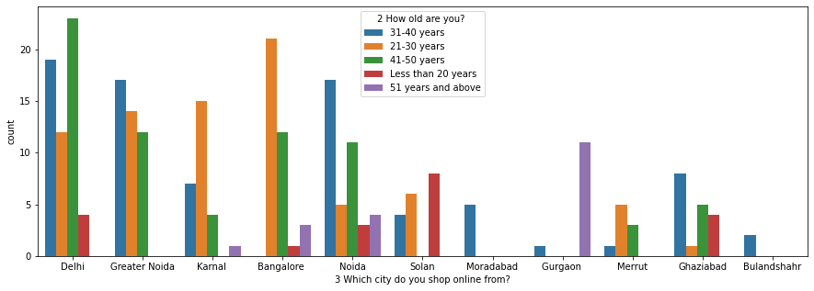
Bivariate analysis (Sample obtained from python notebook)

Slide 8
Next we split the dataset into input and target features.
Assuming that the person will recommend only that website which he/she frequently uses; indicating customer retention by that website, we select 71st column ( 'Which of the Indian online retailer would you recommend to a friend?' ) as the target feature.
Based on the data analysis, we encode the input and output categorical features either using label encoder (for nominal data) or ordinal encoder (for ordinal data)
Balancing is then performed using SMOTE oversampling method incase target class distribution is imbalanced.

Slide 9
The data is scaled using Min-Max scaler so that the distance between the data points is much lesser.
Further, the train_test split is performed with 20% data reserved for test set and 80% for train set.
Since both input and output features are categorical, it is suitable to use chi square function for feature selection.
Using SelectKBest method (with chi square as the function parameter), we extract a list of features with K highest score, that contribute most to the target variable (which is shopping website recommendation).

Slide 10
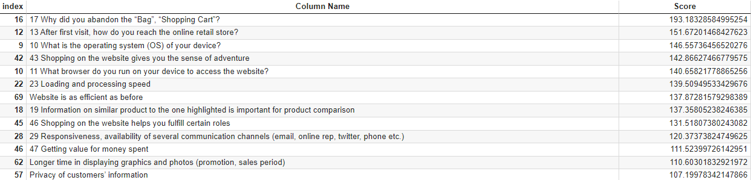
Conclusion
We can conclude that the following key features play a crucial part in customer retention.

